Slide 1


QA CHAPTER
17-JUNE-2021

Slide 2
___
TESTING CONCEPTS
Bushra Awan
QA Engineer - Platform & Discovery Squad

Slide 3








___
WHAT IS A SOFTWARE?
A set of instructions or a program which instructs a computer to do a task.
Software is used in all domains: Fashion, Entertainment, Banking, Healthcare, Insurance, Media

Slide 4

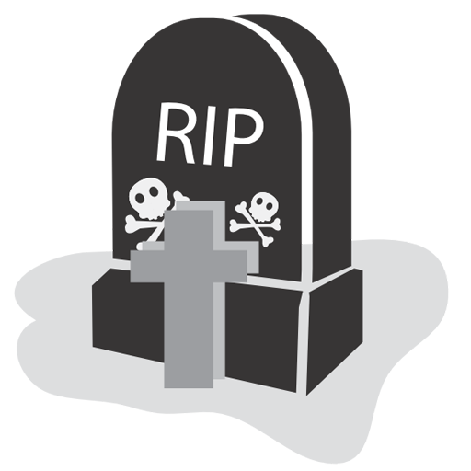

___
CONSEQUENCES OF FAILURE
Software that doesn’t work correctly can lead to many problems like loss of money, time, business reputation and even injury or death.

Slide 5

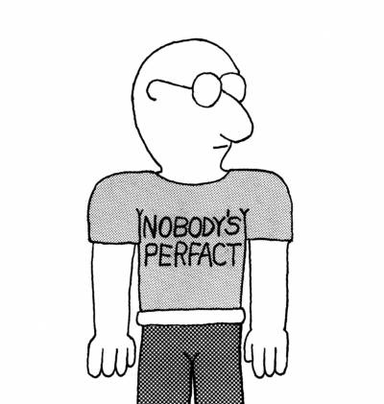


___
WHY SOFTWARE FAILS TO WORK?
Reasons can be many:
Mistake (error) by human → Defect in the code → Failure of the system

Slide 6
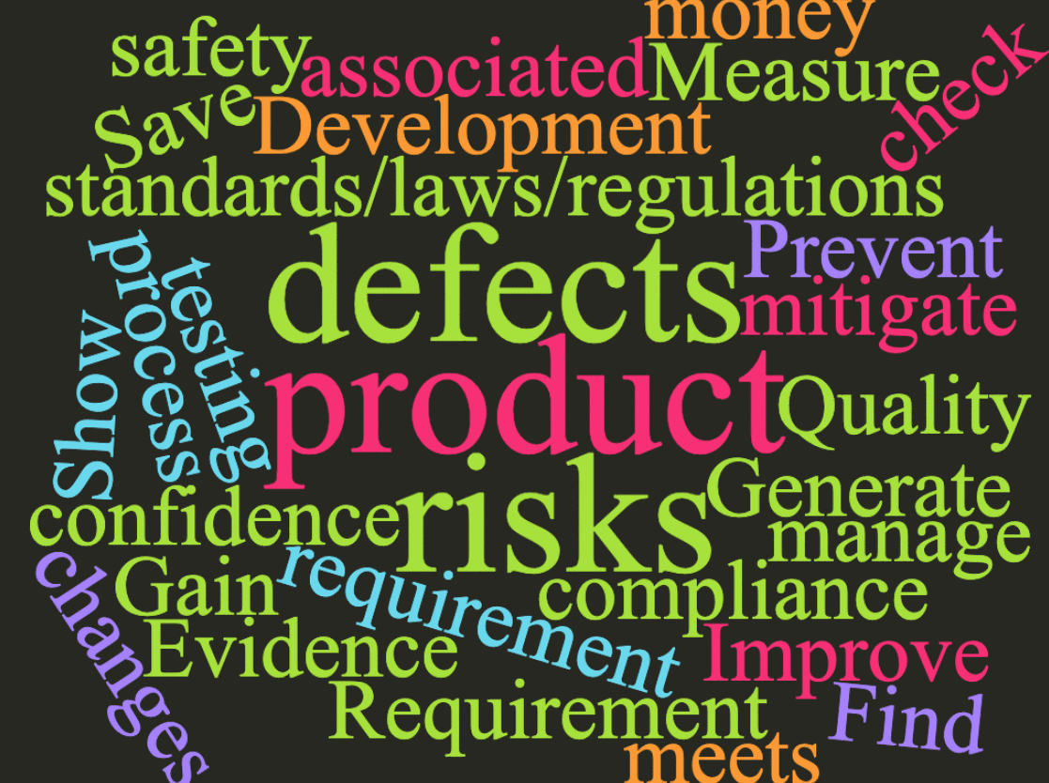
___
WHY TEST?

Slide 7

___
TESTING ACTIVITIES
A common misperception of testing is that it only consists of running tests, i.e, executing the software and checking the results.
Test execution is only one of these activities.
The QA process also includes activities such as test planning, analyzing, designing and implementing tests, reporting test progress and results, and evaluating the quality of a test object
Test execution
Test Preparation
Test Planning

Slide 8
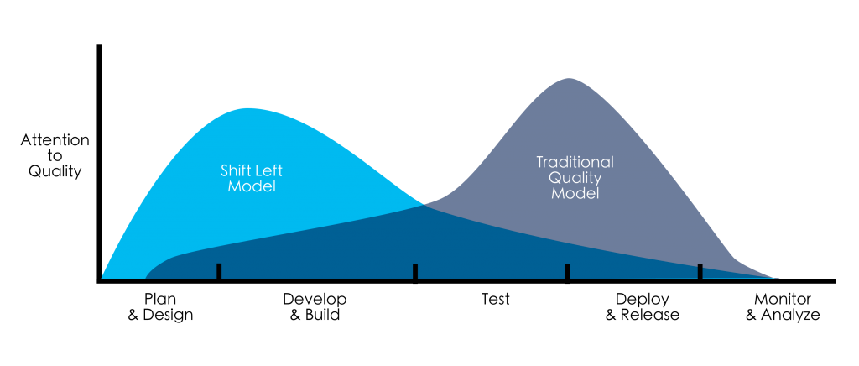
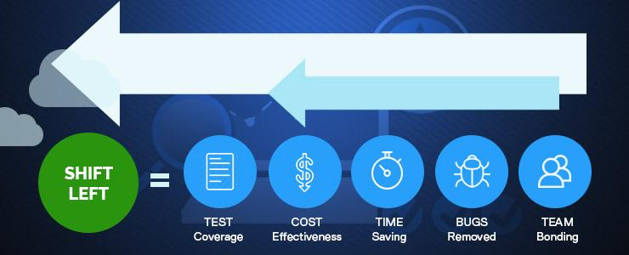
___
SHIFT LEFT?
A defect can arise at any point of the software development life cycle.
It's always better to find a defect as early as possible.
How to promote Shift Left Testing in the team?

Slide 9
___
TESTING PRINCIPLES
Nihal Alfred
Sr. QA Engineer - App Tribe

Slide 10
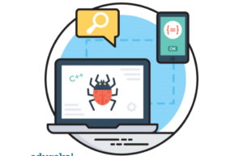
___
PRINCIPLE 1
Testing shows the presence of defects, not their absence
Testing shows that defects are present
It reduces the chance of undiscovered defects remaining in the software
No defects found ≠ proof of correctness

Slide 11

___
PRINCIPLE 2
Exhaustive testing is impossible
Testing everything is infeasible
It is only possible in trivial cases

Slide 12

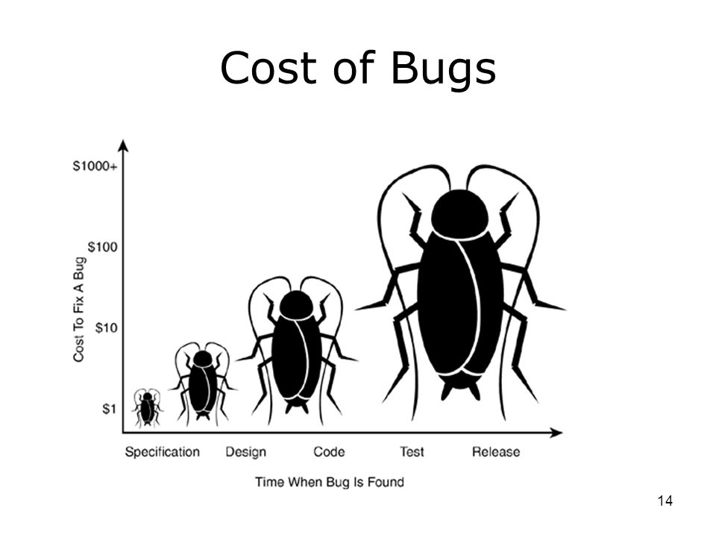
___
PRINCIPLE 3
Early testing saves times and money
To find defects early, testing should be started as early as possible in the development life cycle
Early testing can be called ‘shift left’

Slide 13

___
PRINCIPLE 4
Defects cluster together
A small number of modules usually contain most of the defects found during testing

Slide 14

___
PRINCIPLE 5
Beware of the pesticide paradox
The same tests, repeated continually over time, will eventually stop finding new defects
But to find new defects, tests/data must be regularly revised and new tests written

Slide 15
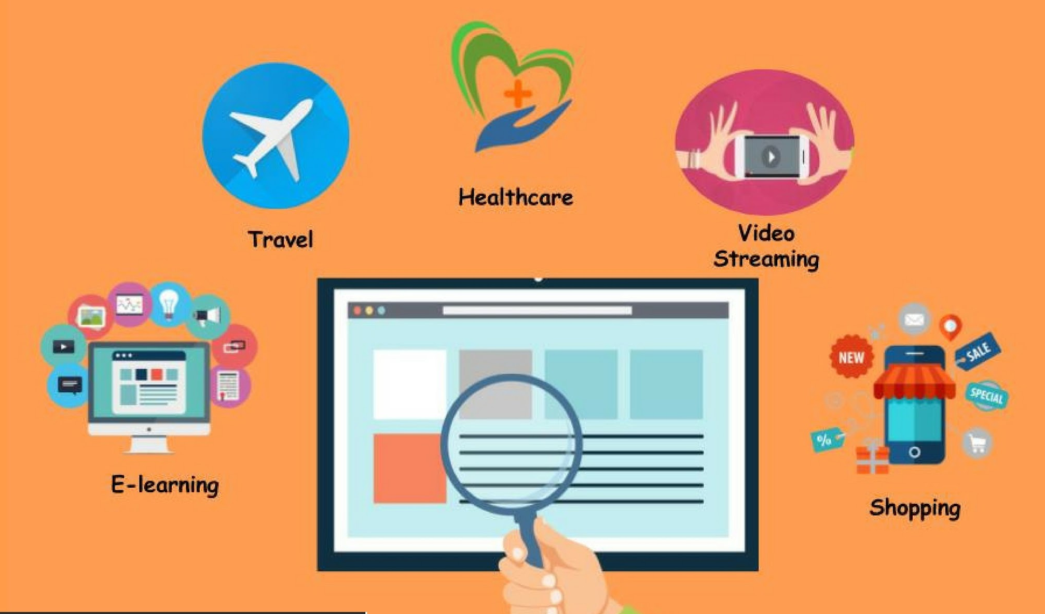
___
PRINCIPLE 6
Testing is context dependent
Testing is done differently in different contexts

Slide 16

___
PRINCIPLE 7
Absence of errors is a fallacy
Finding and fixing defects alone will not ensure the success of a system if the system is:
Difficult to use
Doesn’t fulfill user’s needs and expectations
Inferior to competition

Slide 17

___
Q & A

Slide 18


